Slide 1
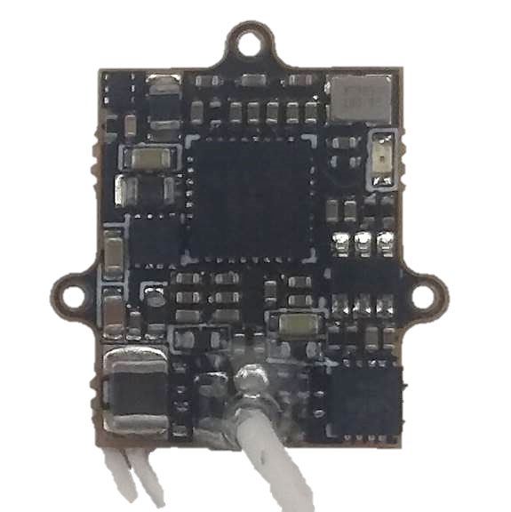
D11
D10
PCLK
V+
GND

Slide 2
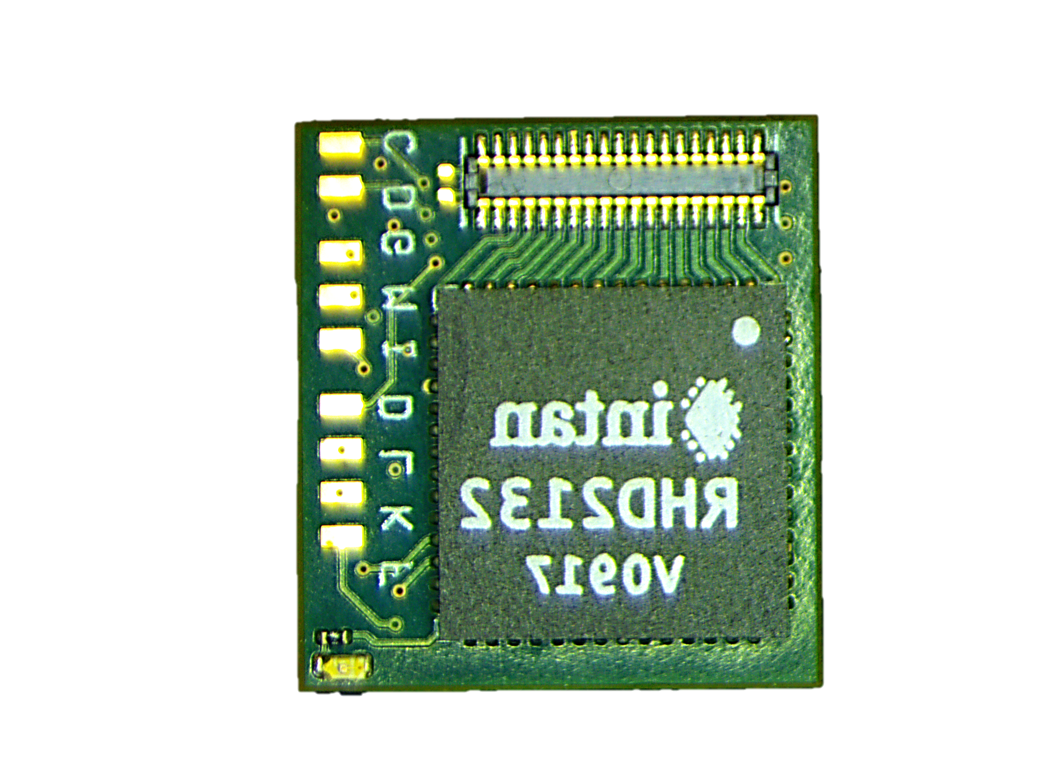
INTAN V+
SSC DATA
SWDIO
MCU V+
SSC Clock
LV
SWCLK
GND
SSC FRAME
Can be shorted to connect vRef to GND

Slide 3
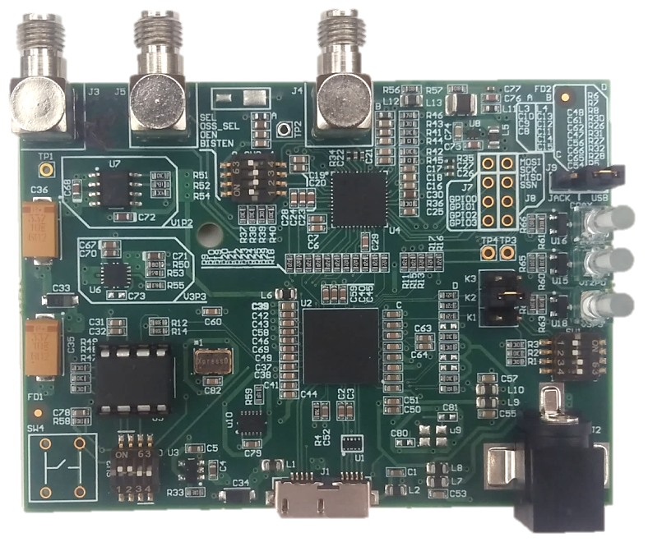
GND
D10
3.3V
D11
PCLK

